Slide 1
LAW OF DEMAND AND SHIFTS IN DEMAND CURVE
NAPINDER KAUR
Assistant Professor

Slide 2

WHAT’S IN THE NEWS?

Slide 3
LEARNING OUTCOMES
After the lecture, you will be able to
Explain the law of demand
Analyse the shifts and movements in the demand curve

Slide 4
DETERMINANTS OF DEMAND
Price of the product
Income of the consumer
Price of related goods
Tastes and preferences
Advertisement
Consumer’s expectation of future income and price
Population
Growth of the economy
Consumer credit

Slide 5


DEMAND FUNCTION
Demand for a product is a function of:
The above function can be expressed in the form of equation also.

Slide 6
LAW OF DEMAND
Other things remaining constant (ceteris paribus), the demand for that commodity is inversely proportional to its price.
Dx = f(Px)
A linear demand function can be expressed as:
Dx = a – bPx

Slide 7
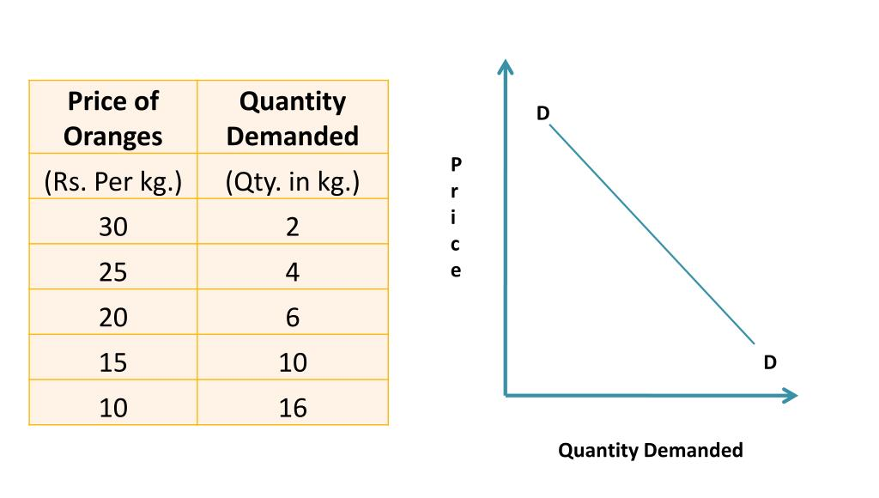
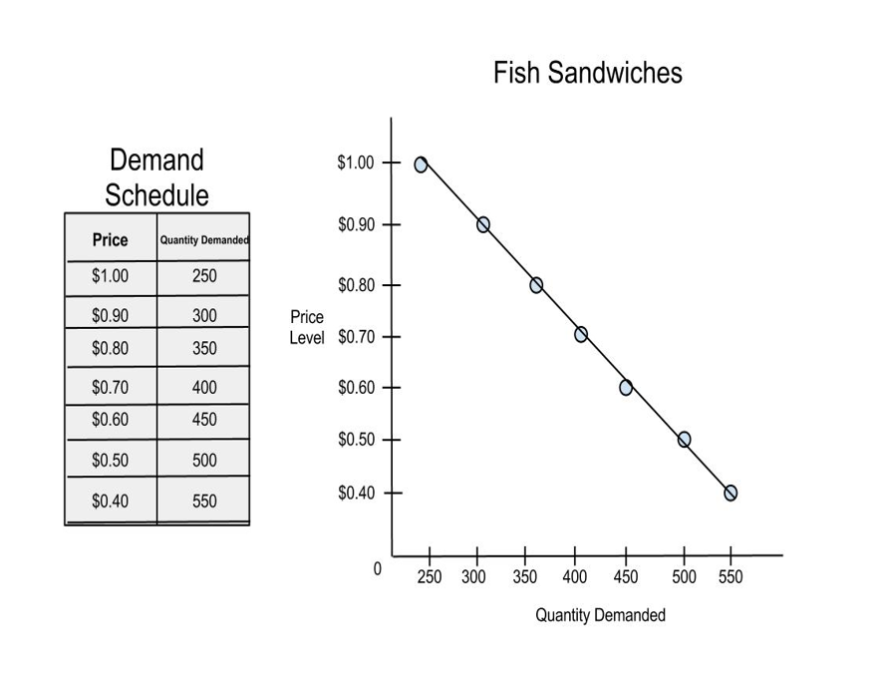
INDIVIDUAL DEMAND SCHEDULE AND DEMAND CURVE

Slide 8
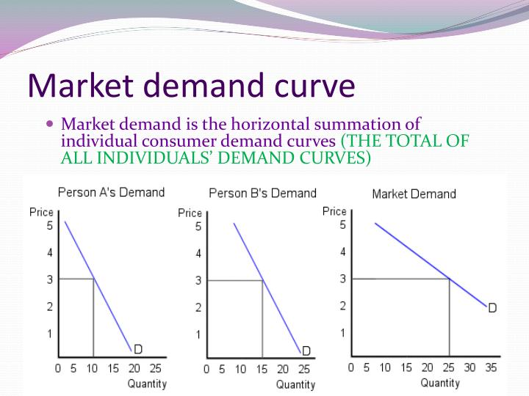
MARKET DEMAND CURVE
Horizontal summation of individual demand curves

Slide 9
EXCEPTIONS TO LAW OF DEMAND
There are some cases where the Law of Demand does not hold good; therefore, these are regarded as exceptions to the Law.

Slide 10
GIFFEN GOODS
Giffen goods display the direct price demand relationship.

Slide 11
SNOB APPEAL
Veblen goods have a snob appeal for which the consumer measures the satisfaction derived not by their utility value, but by social status.

Slide 12
DEMONSTRATION EFFECT
Demonstration effect is the influence on a person’s behaviour by observing the behaviour of others.

Slide 13
FUTURE EXPECTATIONS OF PRICES
Panic buying is when people increase the purchase of goods with the expectation that prices will rise more in the future.

Slide 14
INSIGNIFICANT PROPORTION OF INCOME SPENT
Things of very low value and limited use do not show any impact of price on their demand.

Slide 15
GOODS WITH NO SUBSTITUTES
Demand does not show any effect of price change on the goods which have no substitutes.

Slide 16
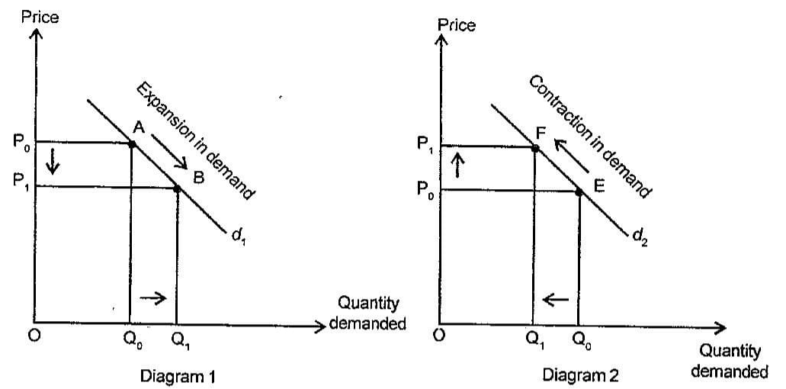
MOVEMENT ALONG THE DEMAND CURVE

Slide 17
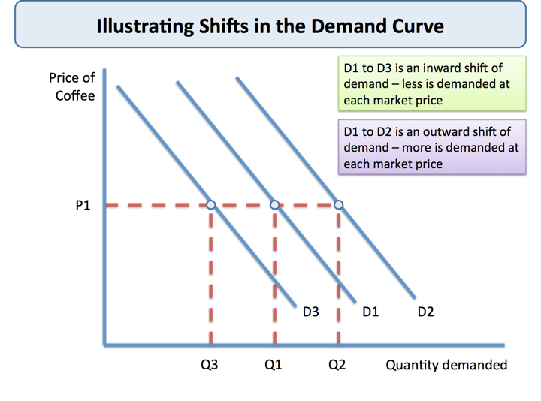
SHIFT IN DEMAND CURVE

